Slide 1




Data Warehousing Project:
University Teradata Challenge’18
Divyesh Batra
Tanushree Kothari
Date - 12/10/2018

Slide 2
Agenda
BikeMS
Business Case
Existing System
Existing System : Drawbacks
Proposed Systems
Implementation
Data Warehouse Architecture
Business Intelligence Reports
Recommendations
Project Management
Challenges Faced
Conclusion

Slide 3
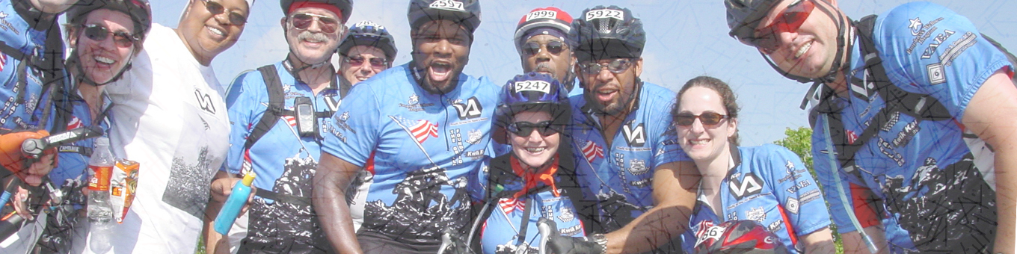
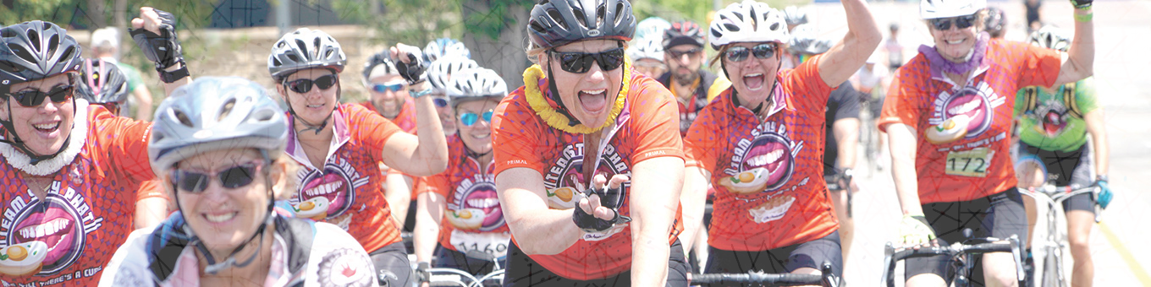
1
BikeMS

Slide 4
2
Charity Cycling Fundraising
Campaign
75000 Cyclists 6000 Teams
National MS Society
$ 68 Millions Raised
Founded in 1946, National Multiple Sclerosis Society (NMSS) is a non-profit organization based in New York

Slide 5
3
Business Case

Slide 6




4
More Participants
To raise awareness of multiple sclerosis as much as possible, BikeMS needs more participants.
TARGET: 80572 riders and 6489 teams
Increased Funding
To materialize National Multiple Sclerosis Society’s vision of a world free of MS, Bike MS needs more funding.
Corporate Acquisition
By spotting growth opportunities and determining competitors’ weakness, capture the highest market share.
DIGITAL ACQUISITION
Analyze the greatest opportunities for digital market investments, compute greatest ROI and provide recommendations for click-conversion rate issue

Slide 7
5
Existing System

Slide 8

6
Donations.csv
Events.csv
File consists of donations provided by donors
File consists of various events organized by BikeMS
Participants.csv
Bike Teams.csv
File consists of participant’s information
File consists of information on corporate teams
National Teams.csv
Affiliates.csv
File consists of information on national teams
File consists of affiliate codes for various chapters of national groups
Bike MS Digital Advertising Reports. xlsx
Google Analytics.csv
File consists of information on area-wise clicks per digital advertisement and various digital platforms
File consists of information about google analytics on different platforms

Slide 9
Existing System: Drawbacks
Reason 1:
Dataset of around 273.5 MB
Aggregated Record Size ~ 4.3 million records
Single view of raw-data
Reason 2:
Data needed from external sources
Limited data importing abilities
Time-consuming process
Reason 3:
Need to maintain historical information
Same cell update leads to loss of information
New historical sheet leads to increased space complexity
Notes:
Single View of Raw data: difficulty in visualization. Thus, generating analytics revolving around multiple spreadsheets with redundant data is not a reliable way to gather insights within a business and predicting future trends to gain competitive advantage.

Slide 10
Proposed Systems: Data Warehouse vs. RDBMS
Data Warehouse
Relational DBMS
To answer BI Questions, data warehouse approach provides varying grain of information which supports multiple sets of same data
Accommodates data storage for any number of applications
In an OLAP database structure, data is organized specifically to facilitate reporting and analysis: data is denormalized to enhance analytical query response times
Optimized for performing read-write operations of single point transactions.
Normalized data in a traditional RDBMS only allows a single grain of information.
Typically constrained to a single application
An OLTP database structure features very complex tables and joins because the data is normalized
Optimized for efficiently reading/retrieving large data sets and for aggregating data.
Notes:
varying grain of information : For example, in order to answer BI needs like corporate acquisitions relevant for biggest events, we can answer the BI need using ‘event-level’ data and on the other hand, in order to answer BI needs like what participant behavior drives fundraising, we can use databases on ‘participant-level’.

Slide 11
9
Data Warehouse: Implementation

Slide 12


Kimball’s Approach
10
Incremental Development
Star-schema
A star schema where facts are connected to multiple dimensions would be suitable as it would provide faster access to queries (BI needs).
This approach will help to develop the skills and techniques required for data warehousing in a much lower risk environment, as they go along the way in an incremental fashion.
Kimball’s Approach
Quick ROI
LOW INITIAL COST
Shorter start up time during initial set up as only a single data mart (subject area) would be designed and developed at a time
Initial cost would be low, and each subsequent phase also will cost the same

Slide 13
11
Data Warehouse Architecture

Slide 14
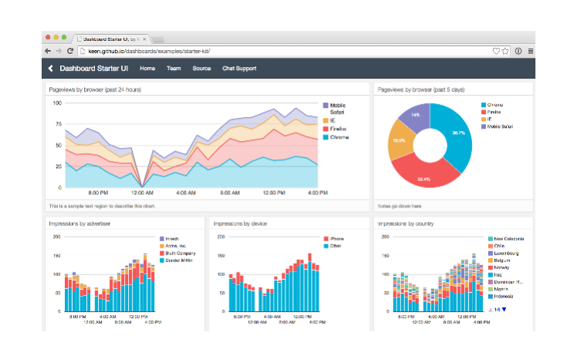




12
ETL
Data Warehouse
Extract
Reports
Transform
STAR Schema
Load

Slide 15
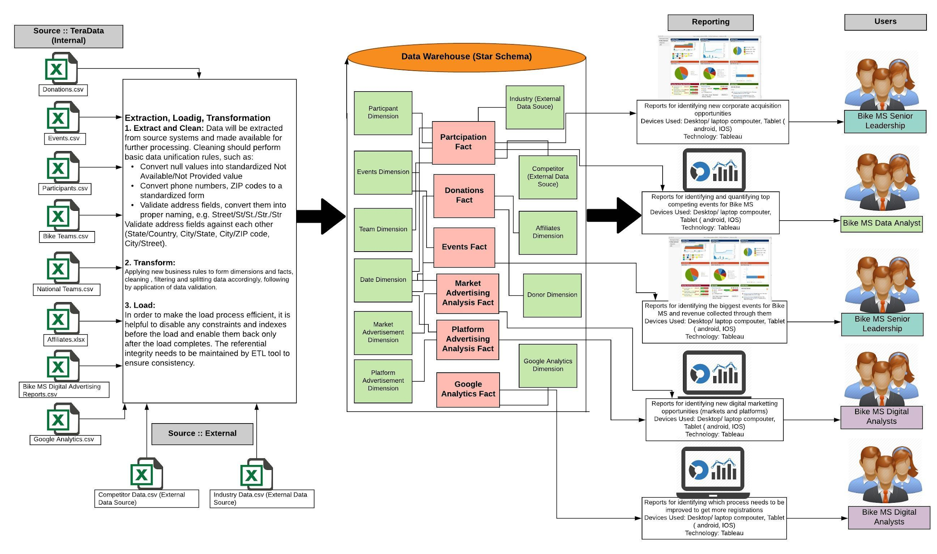
13

Slide 16
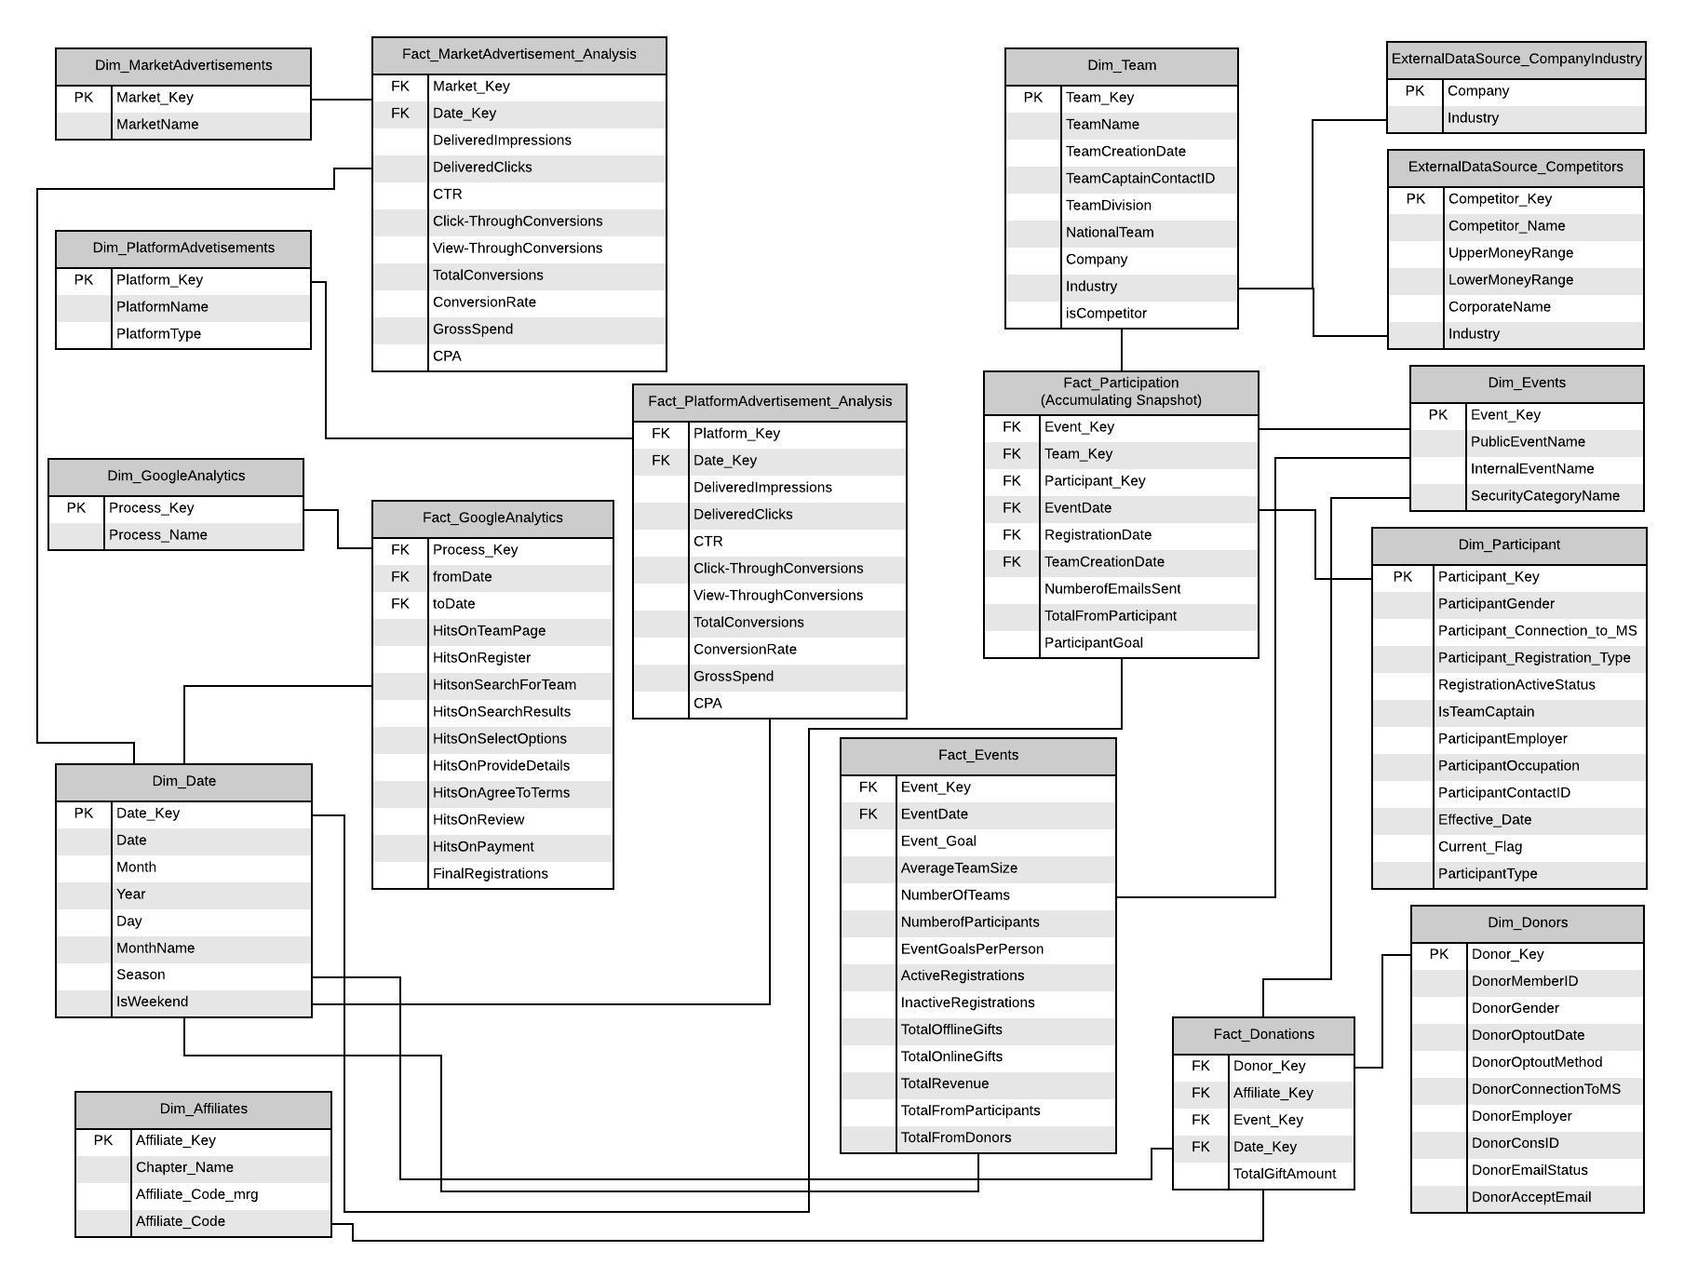
14

Slide 17
15
Business Intelligence Reports

Slide 18
16
What are the greatest growth opportunities for new corporate teams?

Slide 19
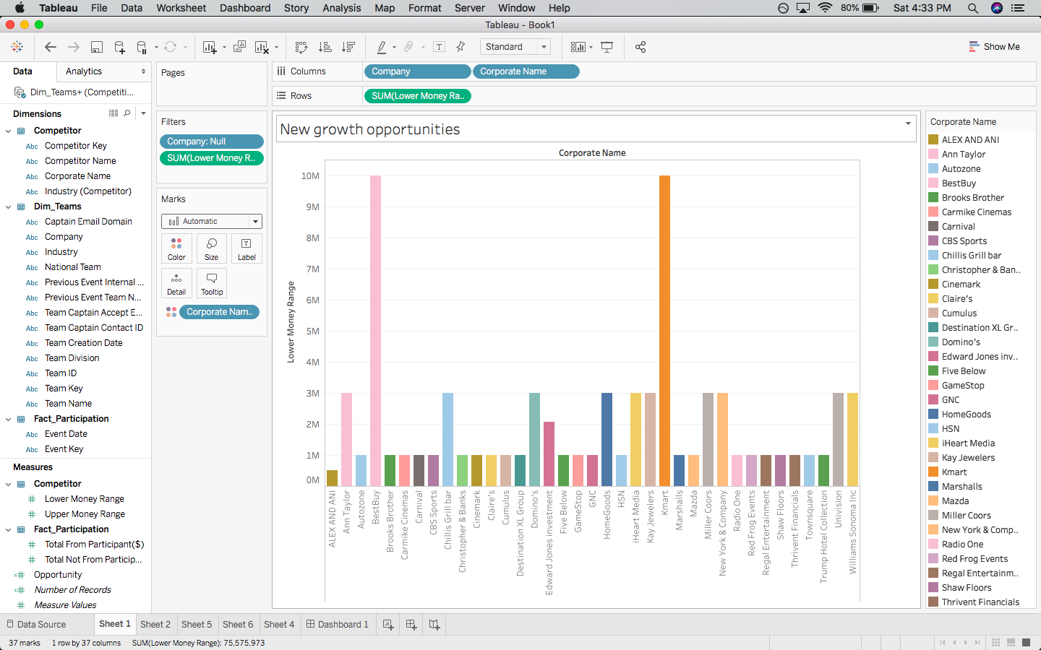












17

Slide 20
18
What industries have had the strongest involvement in Bike MS in the last five years?

Slide 21
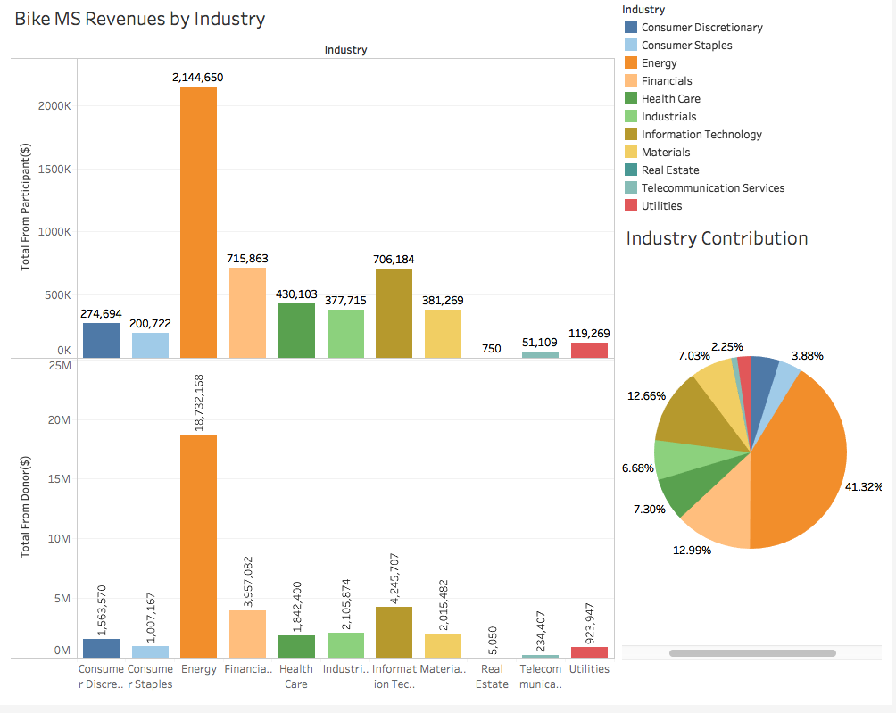
19

Slide 22
20
What occupations were responsible for most of Bike MS’s fundraising?

Slide 23
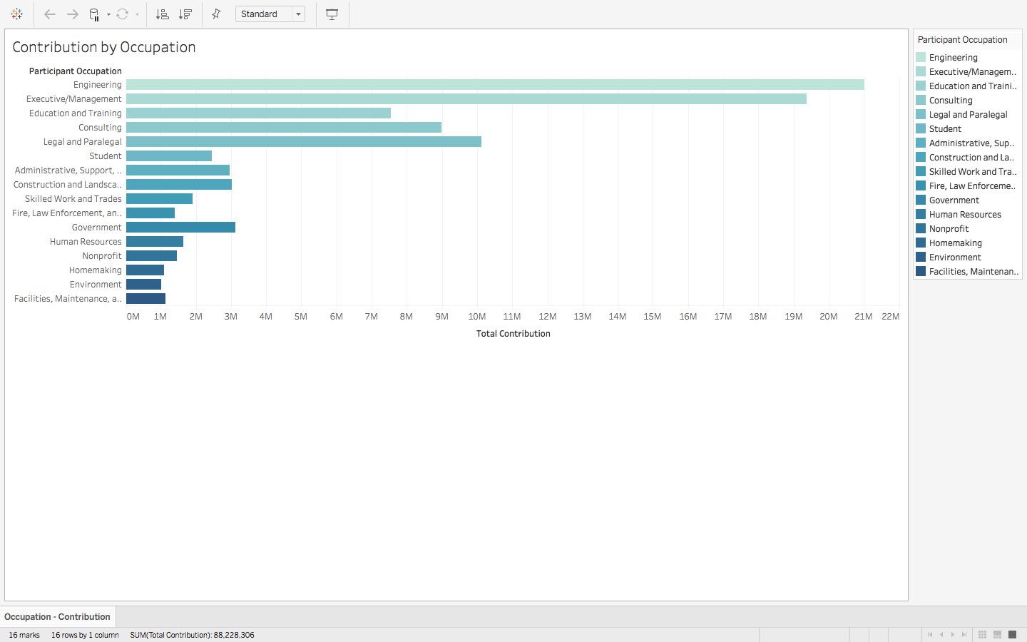
21

Slide 24
22
What are the potential corporate acquisitions opportunity for Bike MS?

Slide 25

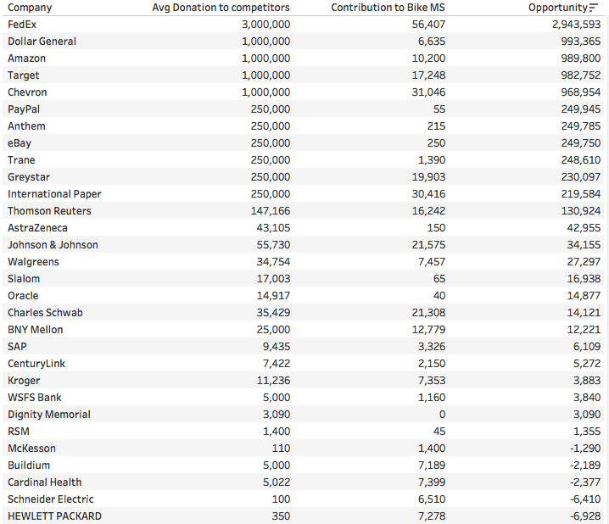




23

Slide 26
24
What are the greatest opportunities for digital marketing investments? Where has BikeMS seen the greatest ROI?

Slide 27
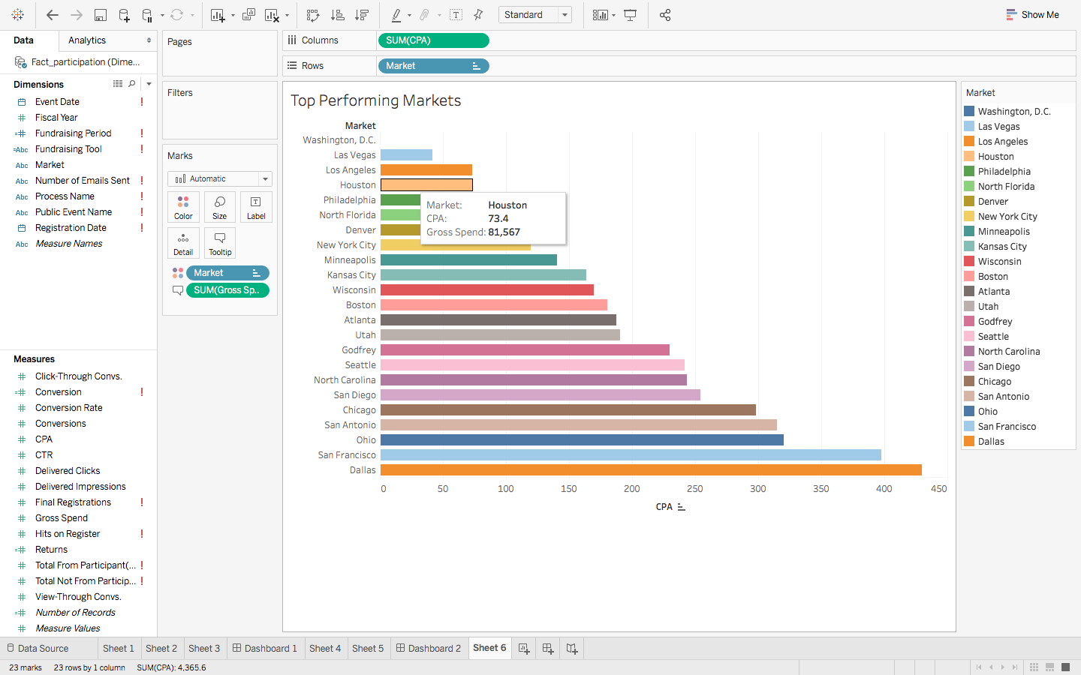
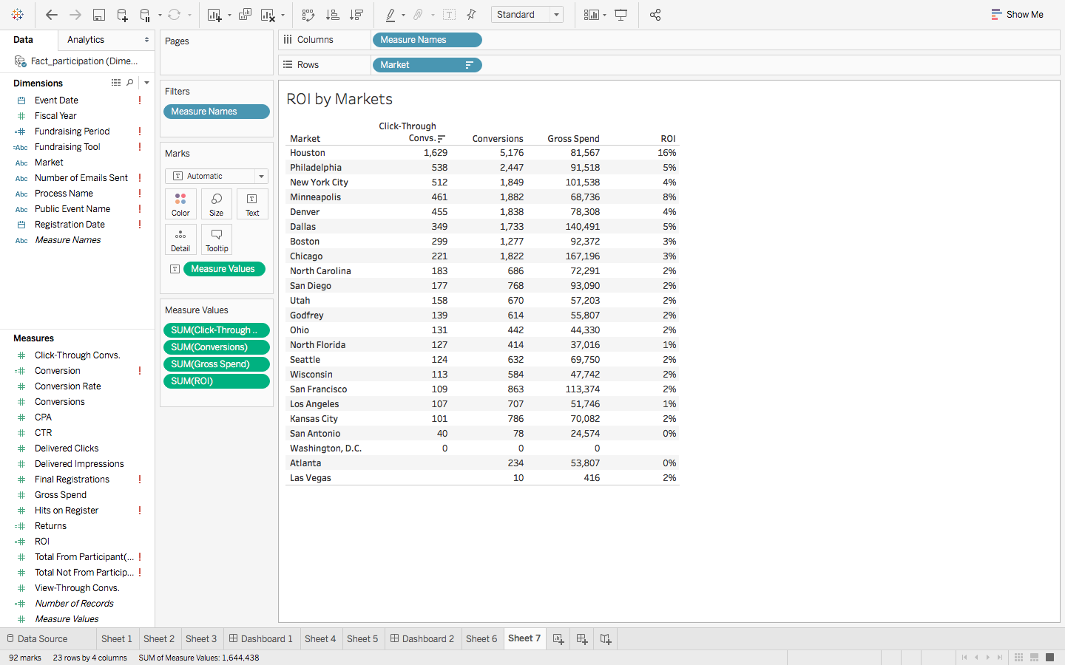
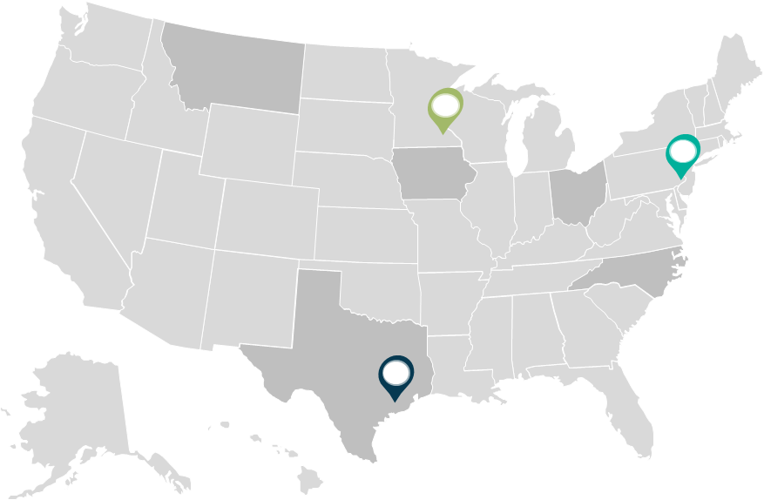
25
Digital marketing trends by market
Minneapolis
Philadelphia
Houston

Slide 28
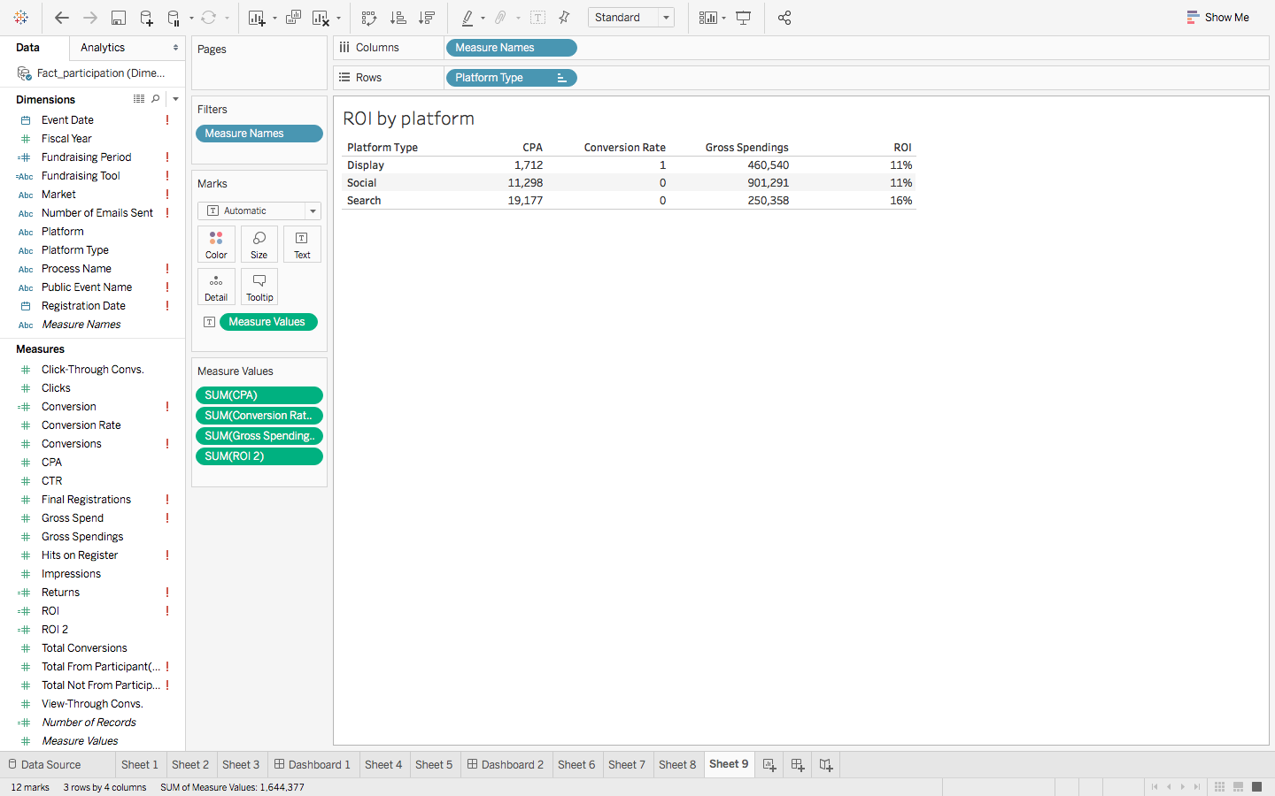
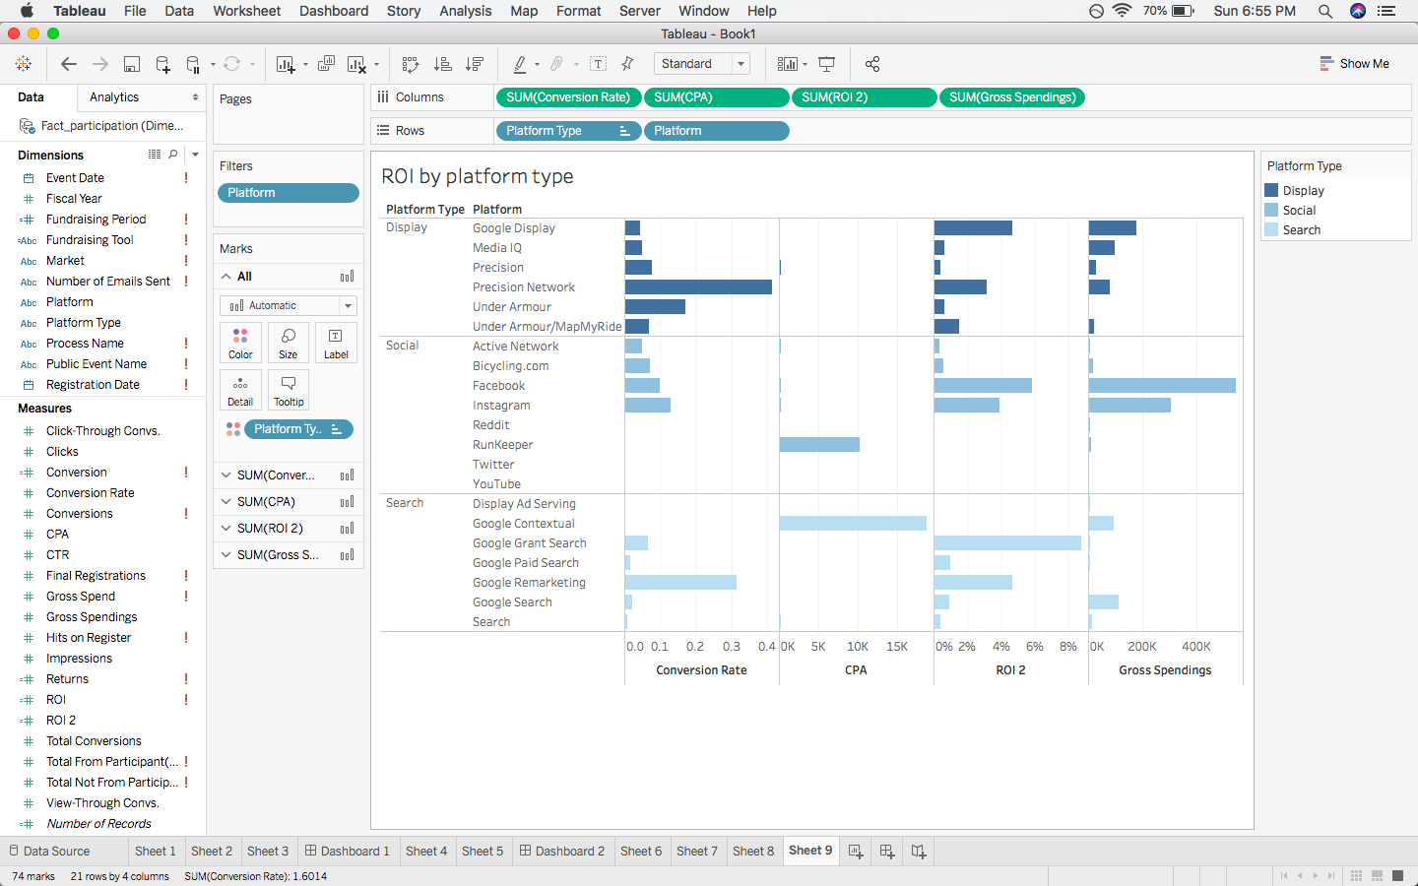
26
Digital marketing trends by platform

Slide 29
27
Recommendations

Slide 30
Industry involvement
The results show that energy, financial, and IT industries had the strongest involvement. Among all industries, engineers and managers tend to donate more money.
EVENT SIZE
Small events attract more participants than medium and big events.
Industry INVOLVEMENT
COMPETITORS
Event Size
The results show ADA – Tour de Cure, Best Buddies, and JDRF are the main competitors of Bike MS
Competitors
Digital media
DIGITAL MEDIA
The return on investment for digital advertisement is high is Houston and Philadelphia. Also, participants use fundraising tools such as Facebook, mobile app, and web page more than others

Slide 31
To reason out the downward trending digital advertising spend vs acquisition, we analyzed the registration process of Best Buddies and compared it with Bike MS.
The registration process for Bike MS is a stepwise, tedious and time-consuming process spanning multiple pages as compared to Best Buddies single sign-in webpage.
Bike MS mandates the participant to enter a minimum fundraising goal of $250 before registering, which is not necessarily needed to be achieved in an event. It might be a potential reason for discouraging participants from signing up. This is optional while registering for Best buddies.
Issue of conversion rate

Slide 32
Challenges Faced &
Future Improvements

Slide 33
Implementation of Data Warehouse
Digital Acquisition
External Data Collection & Web Scraping
Data Science

Slide 34
Project Management

Slide 35
Conclusion

Slide 36


Because Answers exist only to
Questions
Kothari.tanushree@tamu.edu
Divyeshbatra90@tamu.edu

